Slide 1
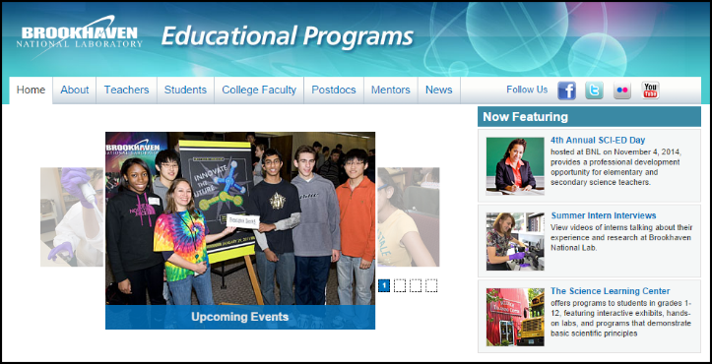

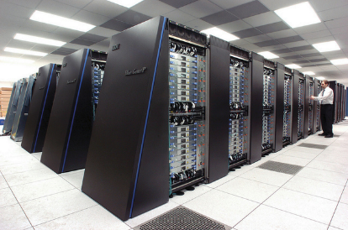
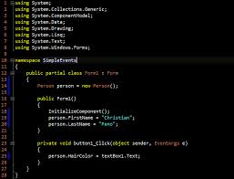
Survey of
Scientific Computing
(SciComp)
Unit 1
Codecademy
GitHub

Slide 2
Goals
Sign-up for Codecademy
Register for classes
Learn about GitHub
Pull Unit 1

Slide 3

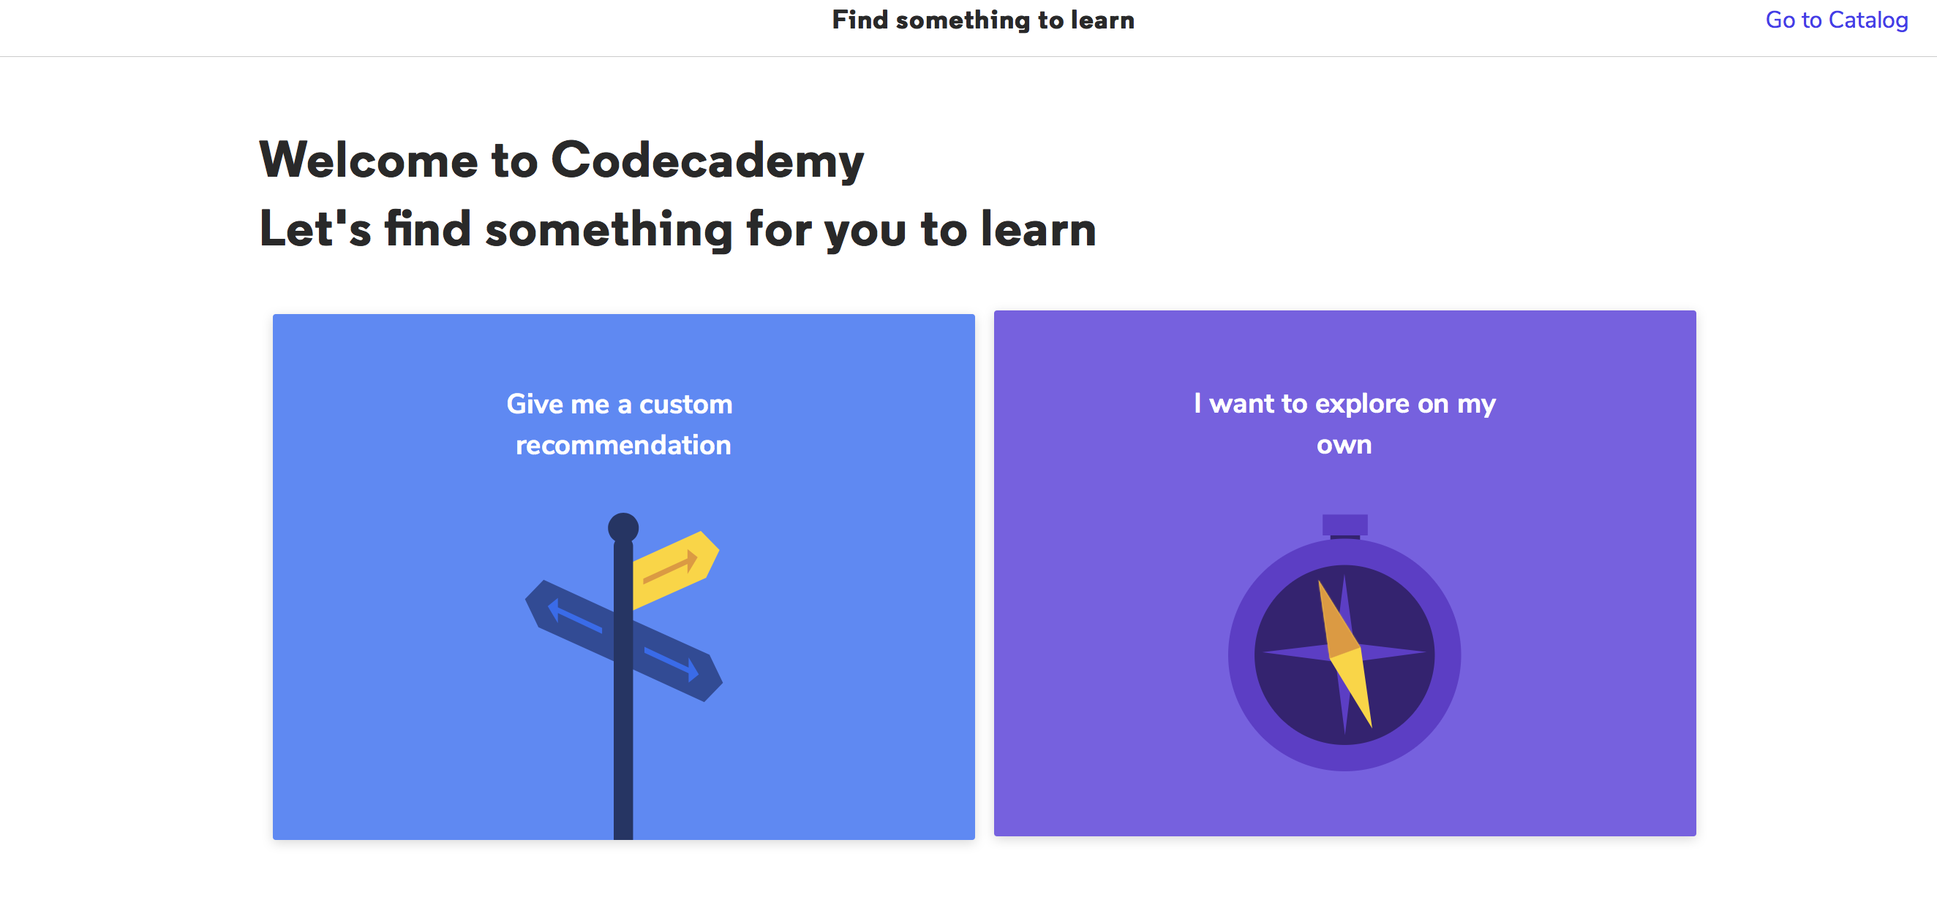
Go to Codecademy.com *We will use this as supplemental lessons
Signup
Use your normal email or google account

Slide 4
Select the following courses
-Learn C++
-Learn the Command Line
-Learn Git
After selecting your first course go to the homepage by clicking the codecademy icon in the top left corner

Slide 5
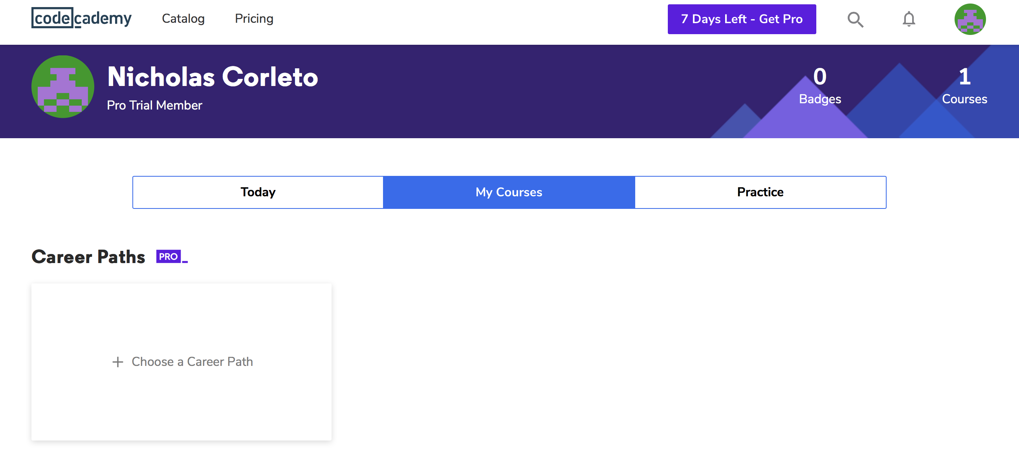
Select My Courses
Scroll to the bottom and Click “Add another course”
*course must be started to be saved to your courses

Slide 6
What is GitHub?
GitHub is a collaboration platform built on top of a distributed version control system called Git. One does not have to worry about losing data on his hard drive or managing a project across multiple computers - one can sync from anywhere. You can track issues, build & test the things and finally deploy.
Why Use of GitHub for Projects?
Version Control (Allows experiments and mistakes without messing up in final product)
Keep your Code in One Place
Great Collaboration Platform
Git, GitHub, GitHub.com, GitHub Desktop,
Hello World - https://guides.github.com/activities/hello-world/
GitHub Guide - https://guides.github.com/

Slide 7
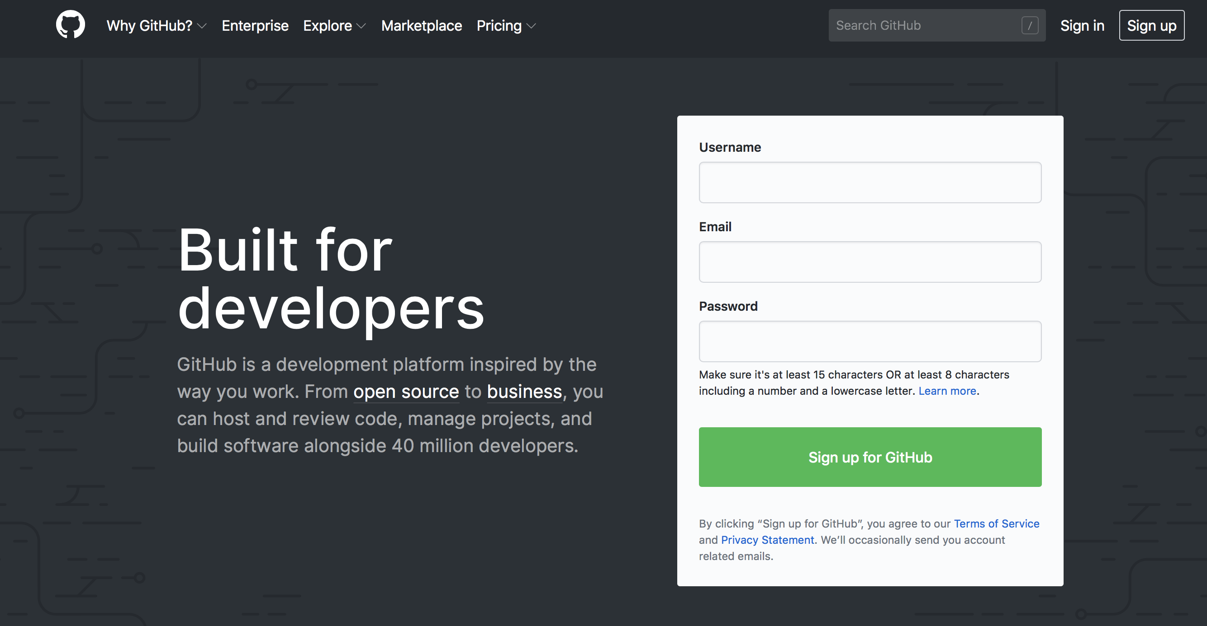
Setting Up With GitHub
Make an account
We will use this later in the year for collaborative projects

Slide 8
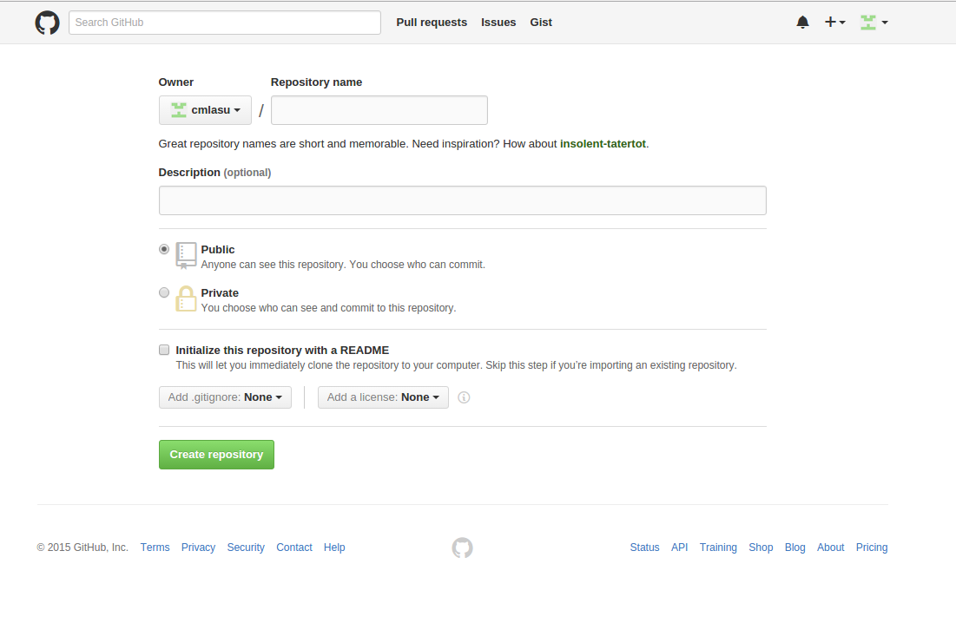
GitHub Repositories
Basic unit of GitHub, most commonly a single project. Repositories can contain folders and files, including images – anything your project needs. ReadME – Project Description
Contains all of the project files (including documentation), and stores each file's revision history.

Slide 9
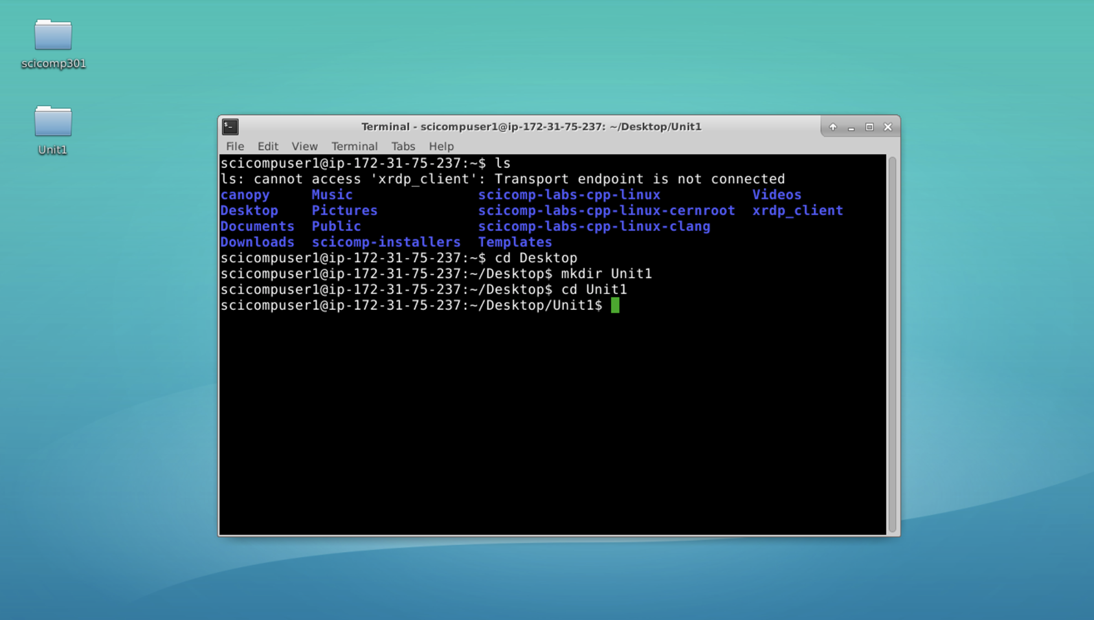
Fetch/Pull Repositories
This is how we will get our course materials on to our Remote Desktops
This will be done via the command line
Import things to note
You must be in the folder you want to download to
Within your Remote Desktop open your terminal window
Go to your desktop folder
Type “cd Desktop”
Make a new folder “Unit1”
Type “mkdir Unit1”
Go to your Unit1 folder
Type “cd Unit1”

Slide 10
User Accounts
Your identity on GitHub. Can be member of any number of organizations. User account includes –
Unlimited public repositories and collaborators on all plans
Personal plans for private repositories
Ability to add unlimited repository collaborators
Two permission levels – repository owner and collaborator(s)
No need to have multiple accounts for different purposes like for business and for personal usage.
User accounts are intended for humans, but you can give one to a robot, such as a continuous integration bot, if necessary.

Slide 11
Organization Teams
Adding people into teams into organization-
https://help.github.com/articles/adding-people-to-teams-in-an-organization/
Adding Users and teams
https://help.github.com/enterprise/11.10.340/admin/articles/adding-users-and-teams/
Permission levels for organization Teams
https://help.github.com/articles/permission-levels-for-an-organization-repository/

Slide 12
Now you know…
How to access your remote Amazon PC
Linux with Xfce is quite similar to Microsoft Windows
How to log out of your Linux (Ubuntu) desktop session

